Slide 1

GLOBAL ACADEMY OF TECHNOLOGY
DEPARTMENT OF COMPUTER SCIENCE AND ENGINEERING
Subject Name | Mini Project | Subject Code | 22CSEP56
Student Name | SHREYA N | USN | 1GA22CS153
 | HARSHITHA NK |  | 1GA22CS071
Domain | MACHINE LEARNING | Group No: | G69
Project Title | “ LOAN APPROVAL PREDICTION ”
Under taken at | GLOBAL ACADEMY OF TECHNOLOGY
Guide Name | PROF.THASEEN TAJ
Notes:
Dept. of CSE, GAT 2017-18

Slide 2
Agenda
Introduction
Problem Statement
Literature Survey
Objectives and Scope of the Mini Project work
Proposed Solution
Requirements Specifications
Methodology/Architecture
Conclusions
Bibliography
Dept of CSE,GAT 2024-25
Notes:
Dept. of CSE, GAT 2017-18

Slide 3
Introduction
Loan approval prediction is an essential process for financial institutions, such as banks and lending companies, to assess whether a borrower is eligible for a loan.
Traditionally, loan decisions have been made based on manual evaluation of various factors like the applicant’s credit score, income level, employment status, and other financial indicators.
While these methods have been effective to some extent, they are often time-consuming, subjective, and susceptible to human error or bias. Furthermore, as the volume of loan applications continues to rise, traditional manual methods become increasingly inefficient.
Dept of CSE,GAT 2024-25

Slide 4
Introduction
With the advent of machine learning and artificial intelligence financial institutions have the opportunity to significantly improve the loan approval process. Machine learning algorithms can automate the decision-making process by learning from historical data and identifying patterns and correlations that humans might overlook.
This allows for more accurate, consistent, and scalable predictions.
The goal of loan approval prediction using machine learning is to assess an applicant’s likelihood of loan repayment and make an informed decision on whether the loan should be approved or denied.
Several machines learning techniques, including classification algorithms such as Logistic Regression, Decision Trees, Random Forests, and Support Vector Machines (SVM), can be applied to predict loan approval outcomes
Dept of CSE,GAT 2024-25

Slide 5
Problem Statement
Predicting loan approval using a dataset containing applicant and loan-related features. The goal is to build a machine-learning model to classify whether a loan application will be approved or not.
Dept of CSE,GAT 2024-25

Slide 6
Literature Survey
SL NO. | TITLE | AUTHOR | YEAR | METHODOLOGY
1 | An Efficient Loan Approval Status Prediction Using Machine Learning | R Nancy Deborah, A Vinora, C Manjula Devi and others | 2023 | This technique is used to convert categorical values, such as gender, marital status, education, and loan status, into numerical values to enhance the accuracy and effectiveness of model evaluation.
2 | Customer Loan Eligibility Prediction using Machine Learning Algorithms in Banking Sector | D. Keerthana, M Kavitha, M Kalyani and others | 2022 | The banking system and applicants able to understand the eligibility of the loan without wasting the processing fee.
Dept of CSE,GAT 2024-25

Slide 7
Literature Survey
SL NO. | TITLE | AUTHOR | YEAR | METHODOLOGY
3 | A Comparative Analysis for Loan Approval Prediction using Machine Learning | Akash Badhan, Abhishek Rana, Simarjit Singh , Param preet Kaur | 2024 | They collected a dataset of 10,000 loan applications from a commercial bank, containing applicant details and loan attributes. The data will undergo cleaning and analysis to uncover patterns and insights for informed decision-making.
4 | Prediction of Modernize d Loan Approval System Based on Machine Learning Approach | Vishal Singh, Ayushman Yadav, Rajat Awasthi, Guide N. Partheeban | 2021 | Data Preprocessing: They preprocessed the data by handling missing values, normalizing features, and transforming categorical variables.
Dept of CSE,GAT 2024-25

Slide 8
Objectives
The main objectives of the Loan Approval Prediction using Machine Learning are:
Analysing the dataset for trends and patterns related to loan approvals.
• Cleaning and preprocessing the data to handle missing or inconsistent values.
• Building predictive models (e.g., classification models) to predict loan approval outcomes.
• Evaluating the model's performance using metrics such as accuracy, precision, recall, or AUC-ROC.
• Providing insights or recommendations based on the analysis
Dept of CSE,GAT 2024-25

Slide 9
Scope of mini project
The project focuses on developing a loan approval prediction system by:
Data Pre-processing: Handling missing values, encoding categorical data, normalizing numerical features, and analyzing key factors like income, credit score, and loan amount.
Model Development: Training and evaluating multiple classification algorithms using metrics like accuracy, precision, recall, and F1-score.
Feature Importance Analysis: Identifying the impact of different features on loan approval decisions for interpretability.
Implementation: Demonstrating integration of the model into loan processing systems for improved efficiency.
Future Enhancements: Exploring deep learning, real-time data, and alternative data sources (e.g., transaction history) for greater scalability and robustness.
Dept of CSE,GAT 2021-22

Slide 10
Proposed Solution
The proposed solution involves developing a data-driven machine learning model that accurately predicts loan approval outcomes based on historical applicant data. The solution will automate and improve the decision-making process by identifying significant factors and patterns from the dataset.
Dept of CSE,GAT 2024-25

Slide 11
Requirements Specifications:
Hardware Requirements
Minimum: Dual-core CPU, 8 GB RAM, 20 GB storage (suitable for small datasets).
Recommended: Quad-core CPU, 16 GB RAM, 50 GB storage, and NVIDIA GPU (for faster training with larger datasets).
Additional: Reliable internet connection and high-resolution monitor for better visualization.
Dept of CSE,GAT 2021-22

Slide 12
Requirements Specifications :
Software Requirements
Operating System
Windows 10 or higher / macOS / Linux (Ubuntu or similar distribution).
Programming Language
Python (preferred) or R for model development and data preprocessing.
Libraries/Frameworks
For Data Preprocessing:
  Pandas, NumPy,Pickle.
For Machine Learning Models:
Sklearn.
For Visualization:
  Matplotlib, Seaborn.
Development Environment
Jupyter Notebook (for prototyping and experimentation).
PyCharm, VS Code, or any preferred IDE for development.
Dept of CSE,GAT 2021-22

Slide 13
Methodology/Architecture
Data Exploration and Cleaning:
Analyse the dataset's structure and missing values.
Handle missing values using appropriate imputation strategies (e.g., median, mode).
Detect and visualize outliers using boxplots.
2. Feature Engineering:
Create new features like "Total Income."
Apply logarithmic transformations to normalize skewed distributions.
Drop irrelevant columns to simplify the dataset.
3. Data Encoding:
Convert categorical variables into numerical formats using Label Encoding.
Dept of CSE,GAT 2024-25

Slide 14
Methodology
4. Data Splitting:
Split the dataset into training and testing sets.
Address class imbalance using oversampling techniques (e.g., Random Oversample).
5. Model Training:
Train various machine learning models (Logistic Regression, Decision Tree, Random Forest, and K-Nearest neighbours).
Evaluate models using metrics like accuracy and classification reports.
Perform cross-validation to validate model robustness.
6. Performance Comparison
Compare model performance before and after addressing class imbalance.
Generate classification reports for detailed performance metrics.
Dept of CSE,GAT 2021-22

Slide 15
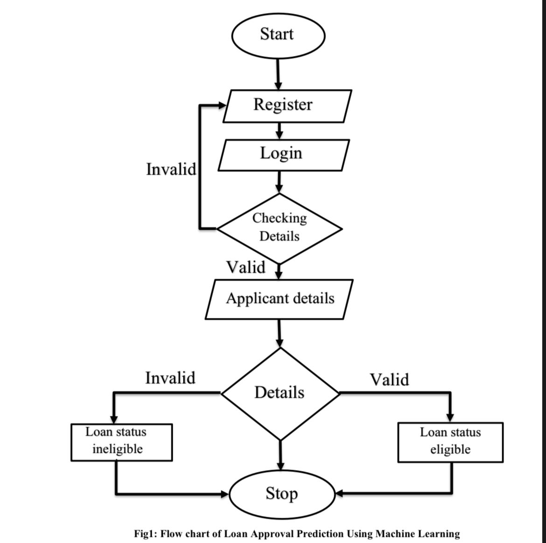
Sample : Architecture
Dept of CSE,GAT 2024-25

Slide 16
Conclusions
In conclusion, leveraging machine learning for loan approval prediction presents a significant advancement for financial institutions. By automating and refining the decision-making process, machine learning models offer improved accuracy, consistency, and scalability compared to traditional manual evaluation methods.
These models can effectively analyze complex datasets, identify patterns, and provide unbiased predictions, enabling institutions to assess borrowers more fairly and efficiently.
The adoption of techniques like Logistic Regression, Decision Trees, Random Forests, and Support Vector Machines empowers organizations to handle growing application volumes while minimizing human error and bias. As the financial sector continues to embrace technological innovation, machine learning will play a crucial role in creating a more efficient, transparent, and customer-centric loan approval process.
Dept of CSE,GAT 2024-25

Slide 17
Bibliography
[1] R Nancy Deborah, S Alwyn Rajiv, A Vinora, C Manjula Devi, “An Efficient Loan Approval Status Prediction Using Machine Learning”, 2023 International Conference on Advanced Computing Technologies and Applications (ICACTA), 2023 International Conference on Advanced Computing Technologies and Applications (ICACTA) | 979-8-3503-4834-7/23/$31.00 ©2023 IEEE | DOI: 10.1109/ICACTA58201.2023.10392691.
[2] Ch. Naveen Kumar, D. Keerthana, M Kavitha, M Kalyani, “Customer Loan Eligibility Prediction using Machine Learning Algorithms in Banking Sector”, Proceedings of the Seventh International Conference on Communication and Electronics Systems (ICCES 2022) IEEE Xplore Part Number: CFP22AWO-ART; ISBN: 978-1-6654-9634-6, 2022 7th International Conference on Communication and Electronics Systems (ICCES) | 978-1-6654 9634-6/22/$31.00 ©2022 IEEE | DOI: 10.1109/ICCES54183.2022.9835725.
[3] Akash Badhan, Abhishek Rana, Simarjit Singh Malhi, Parampreet Kaur, “A Comparative Analysis for Loan Approval Prediction using Machine Learning”, 2024 International Conference on Electrical Electronics and Computing Technologies (ICEECT), 2024 International Conference on Electrical Electronics and Computing Technologies (ICEECT) | 979-8-3503-7809-2/24/$31.00 ©2024 IEEE | DOI: 10.1109/ICEECT61758.2024.10738925.
[4] Vishal Singh, Ayushman Yadav, Rajat Awasthi, Guide N. Partheeban, “Prediction of Modernized Loan Approval System Based on Machine Learning Approach”, 2021 International Conference on Intelligent Technologies (CONIT) Karnataka, India. June 25 27, 2021, 2021 International Conference on Intelligent Technologies (CONIT) | 978-1-7281 8583-5/21/$31.00 ©2021 IEEE | DOI: 10.1109/CONIT51480.2021.9498475.
Dept of CSE,GAT 2021-22

Slide 18
Thank You
Dept of CSE,GAT 2024-25

Slide 19
Q & A
Dept of CSE,GAT 2024-25

